Slide 1
Computer Organization & Assembly Language
3 – System Bus & Register

Slide 2
Outline
The Components of Microcomputer System
System Bus
Data, Address & Control
The CPU
Registers

Slide 3
System Bus

Slide 4
What is a Bus?
A communication pathway connecting two or more devices
Often grouped
A number of channels in one bus
e.g. 32-bit data bus is 32 separate single bit channels
Address Bus
CPU
Memory
I/O
Control Bus
Data Bus

Slide 5
Data Bus
Carries data
Remember that there is no difference between “data” and “instruction” at this level
Width is a key determinant of performance
8, 16, 32, 64 bit

Slide 6
Address bus
Identify the source or destination of data
e.g. CPU needs to read an instruction (data) from a given location in memory
Bus width determines maximum memory capacity of system
e.g. 8080 has 16 bit address bus giving 64k address space

Slide 7
Control Bus
Control and timing information
Memory read/write signal
Interrupt request
Clock signals

Slide 8
Types of Transfer
Memory to Processor
Processor to Memory
I/O to Processor
Processor to I/O
I/O to and from Memory

Slide 9
Interconnection Structure
Memory
N words of equal length, each word having a unique address
Unit of Transfer (read/Write): Word
Operation: Read/Write indicated by Control Signal
Location of operation specified by an address
I/O Module (Middleman)
Two operations: read and write
May control other external devices
Port: interface between I/O module and device
Able to send interrupt signal to CPU

Slide 10
Contd..
CPU
Reads in instruction and data
Writes out data
Uses control signal to control all operations
Receives interrupt signal

Slide 11
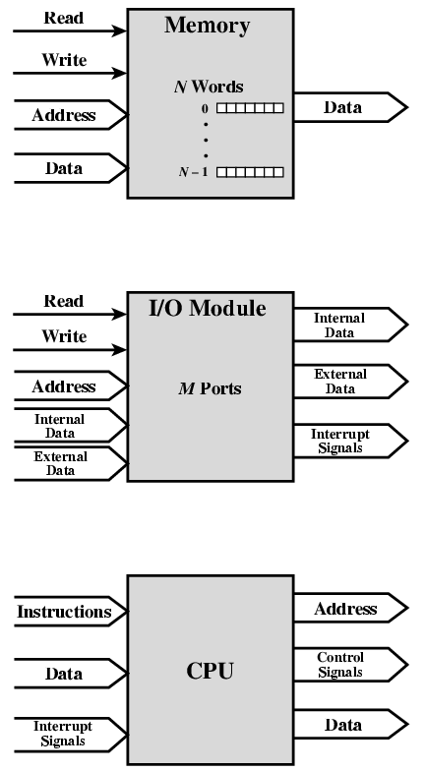
Address
Data Read
Data Write
Interrupt Signals

Slide 12
Registers

Slide 13
Registers
Registers are high-speed storage locations inside the microprocessor.
Designed to be accessed at much higher speed than conventional memory.
Registers are classified according to the functions they perform.
General Types of Registers:
Data Registers: To hold data for an operation.
Address Registers: To hold the address of an instruction or data.
Status/Flag Register: keeps the current status of the processor or result of an arithmetic operation.

Slide 14
8086 Internal registers 16 bits (2 bytes each)
AX, BX, CX and DX are two
bytes wide and each byte can
be accessed separately
These registers are used as
memory pointers.
6 status; 3 control ; 7 unused
Segment registers are used
as base address for a segment

Slide 15
General Purpose/Data Registers
Following four registers are available to the programmer for general data manipulation:
AX (Accumulator): Used in arithmetic, logic and data transfer instructions. Also required in multiplication, division and input/output operations.
BX (Base): It can hold a memory address that points to a variable.
CX (Counter): Act as a counter for repeating or looping instructions. These instructions automatically repeat and decrement CX and quit when equals to 0.
DX (Data): It has a special role in multiply and divide operations. Also used in input/output operations.

Slide 16
Segment Registers
Store addresses of instruction and data in memory.
These values are used by the processor to access memory locations.
CS (Code): Defines the starting address of the section of memory holding code.
DS (Data): Defines the section of memory that holds most of the data used by programs.
ES (Extra): This is an additional data segment that is used by some of the string instructions.
SS (Stack): It defines the area of the memory used for stack

Slide 17
Pointers and Index Registers
These can be accessed only as 16 bit registers.
IP - instruction pointer: Always points to next instruction to be executed. IP register always works together with CS segment register and it points to currently executing instruction.
SI - source index register: Can be used for pointer addressing of data. Offset address relative to DS
DI - destination index register: Can be used for pointer addressing of data . Offset address relative to ES
SI and DI used in string movement instructions.
SP and BP are used to access data inside the stack segment
BP - base pointer: Primarily used to access parameters passed via the stack. Offset address relative to SS
SP – stack pointer: Always points to top item on the stack. Offset address relative to SS

Slide 18
80386 Extended Registers
The 80386/80486 processor contain 32-bit registers which greatly improve the efficiency of program that take advantage of them.
EAX, EBX, ECX, EDX,
EFLAGS
EIP
EBP, ESP, ESI, EDI.

